Slide 1
CHILD EDUCATION
PRESENTATION ON DESIRED CLASS ROOM FLOOR PLAN FOR AGE 18-24 Months .

Slide 2
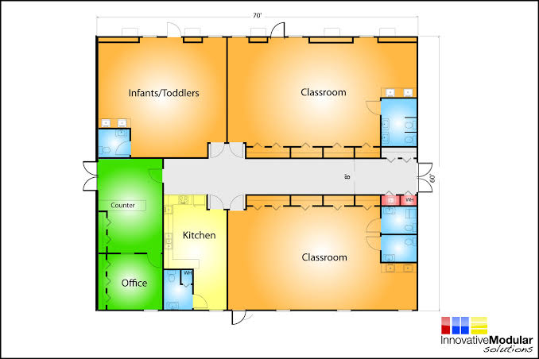
CLASS FLOOR PLAN

Slide 3
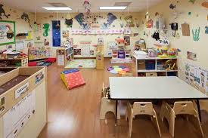
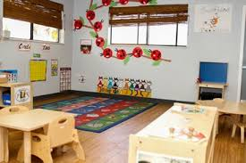
CLASS ROOM IMAGES
Toddler age 1 and 2
Toddler age 1

Slide 4
ANSWERS TO QUESTIONS
1) I will definitely use white on the walls. This is because white is flamboyant and leaves the room lively. Further, a blend of yellow charts on the wall shall also be incorporated. Yellow creates a positive feeling.
2)The class shall be arranged in a manner in which it allows for the children to boost their development through work and play. This shall be accomplished through the installation of study tables and additional playing tools.

Slide 5
Quiz 3) The images are so beautiful, that I wish I were a toddler. Furthermore, the image of a child crawling up the stare case looks cute. Its amazing how the child moves around confidently
Quiz 4) My classroom will definitely exude a mood of excellence. This is evident from the choice of color. For instance yellow will forever shout a positive feeling.
Quiz 5?) I will probably prefer carpet to cover most parts of the floor. This makes the floor warm for even children to play on. Furthermore, cold is harmful to children.
Quiz 6) Soft elemen

Slide 6
Quiz 7) Time for play in the schedule shall be incorporated based on how the children respond to class session. If they are mostly in active in the afternoon, then they will probably play in the afternoon hours .
Quiz 8 ) The children shall be provided with the following to boost their development. Toys like baby dolls, floor puzzles, wooden blocks for building.
Quiz 9) We shall focus more on art , block and literacy.
Quiz 10) The classroom shall have different stations. Section with tables and chairs for quick interaction with pencils and drawing materials.

Slide 7
Conclusion
This particular classroom shall be spacious. It shall have well arranged playing section as well as a study section. The interior design is quite simple and unique. The choice of white, blends with yellow, and this makes the room lively.

